Slide 1
Strings

Slide 2
Motivations
Often you encounter the problems that involve string processing and file input and output. Suppose you need to write a program to replace all occurrences of a word with a new word in a file. How do you solve this problem?

Slide 3
Constructing Strings
String message = new String("Welcome to Java");
Since strings are used frequently, Java provides a shorthand initializer for creating a string:
String message = "Welcome to Java";

Slide 4
Strings Are Immutable
A String object is immutable; its contents cannot be changed. Does the following code change the contents of the string?
String s = "Java";
s = "HTML";

Slide 5
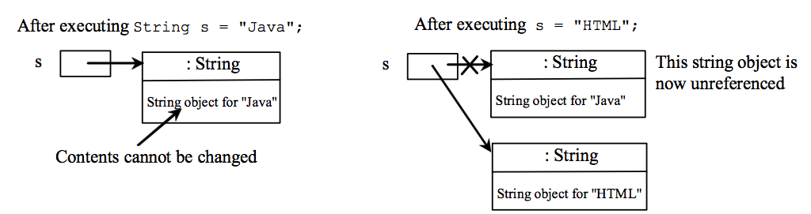
Trace Code
animation
String s = "Java";
s = "HTML";

Slide 6
Trace Code
animation
String s = "Java";
s = "HTML";

Slide 7
Interned Strings
Since strings are immutable and are frequently used, to improve efficiency and save memory, the JVM uses a unique instance for string literals with the same character sequence. Such an instance is called interned. For example, the following statements:

Slide 8
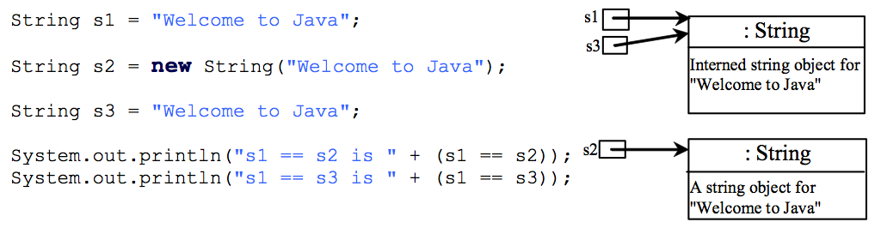
Examples
display
s1 == s2 is false
s1 == s3 is true
A new object is created if you use the new operator.
If you use the string initializer, no new object is created if the interned object is already created.

Slide 9
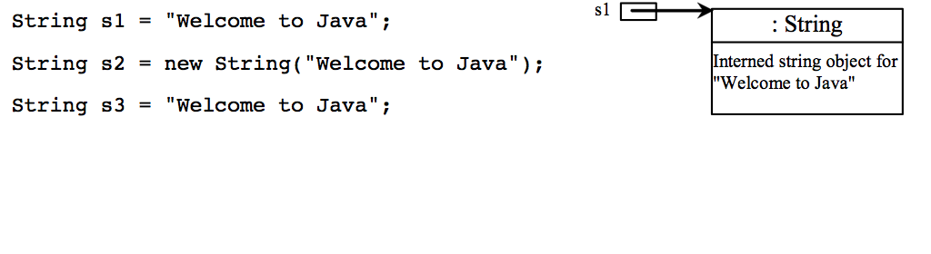
Trace Code
animation

Slide 10
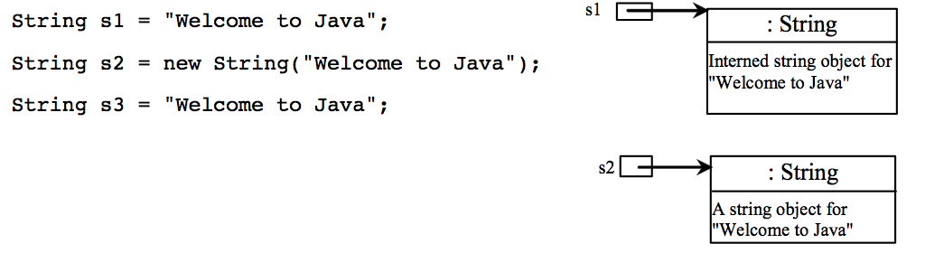
Trace Code

Slide 11
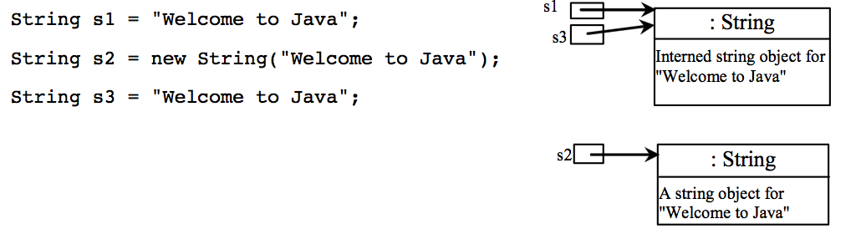
Trace Code

Slide 12
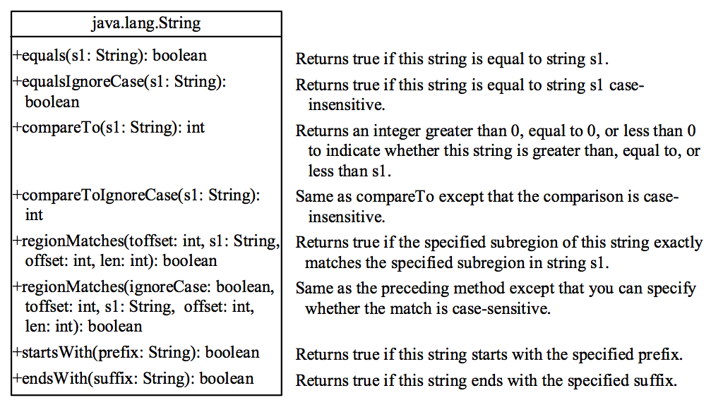
String Comparisons

Slide 13
String Comparisons
equals:
String s1 = new String("Welcome“);
String s2 = "welcome";
if (s1.equals(s2)){
// s1 and s2 have the same contents
}
if (s1 == s2) {
// s1 and s2 have the same reference
}

Slide 14
String Comparisons, cont.
compareTo(Object object):
String s1 = new String("Welcome“);
String s2 = "welcome";
if (s1.compareTo(s2) > 0) {
// s1 is greater than s2
}
else if (s1.compareTo(s2) == 0) {
// s1 and s2 have the same contents
}
else
// s1 is less than s2

Slide 15
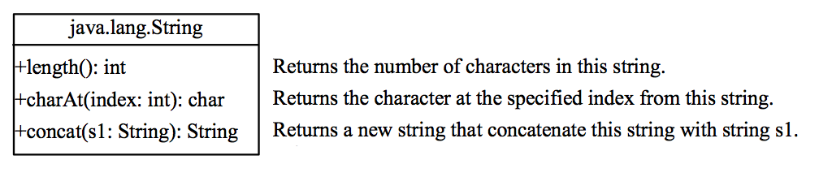
String Length, Characters, and Combining Strings

Slide 16
Finding String Length
Finding string length using the length() method:
message = "Welcome";
message.length() (returns 7)

Slide 17
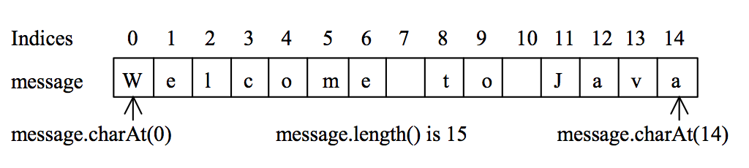
Retrieving Individual Characters in a String
Do not use message[0]
Use message.charAt(index)
Index starts from 0

Slide 18
String Concatenation
String s3 = s1.concat(s2);
String s3 = s1 + s2;
s1 + s2 + s3 + s4 + s5 same as
(((s1.concat(s2)).concat(s3)).concat(s4)).concat(s5);

Slide 19
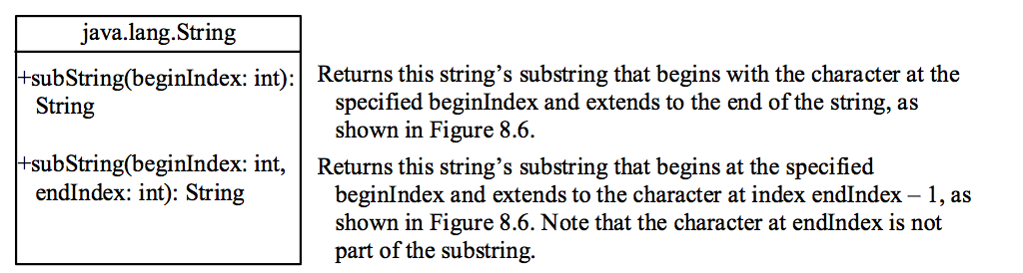
Extracting Substrings

Slide 20
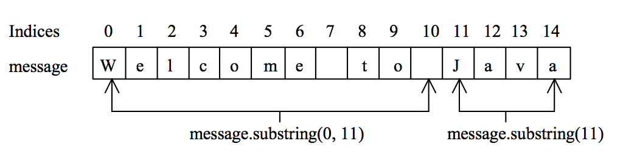
Extracting Substrings
You can extract a single character from a string using the charAt method. You can also extract a substring from a string using the substring method in the String class.
String s1 = "Welcome to Java";
String s2 = s1.substring(0, 11) + "HTML";

Slide 21
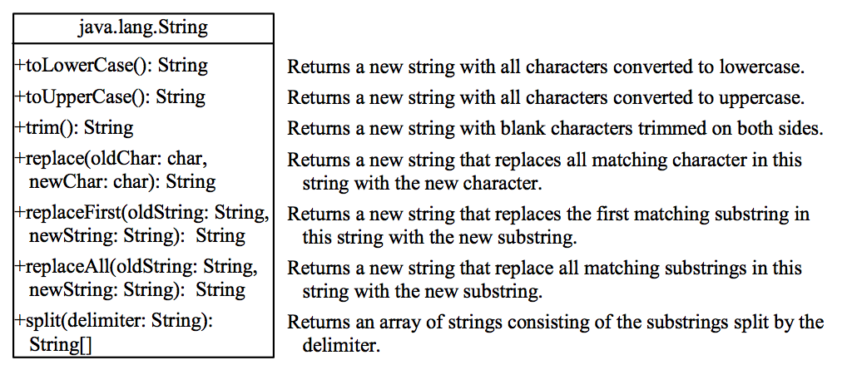
Converting, Replacing, and Splitting Strings

Slide 22
Examples
"Welcome".toLowerCase() returns a new string, welcome.
"Welcome".toUpperCase() returns a new string, WELCOME.
" Welcome ".trim() returns a new string, Welcome.
"Welcome".replace('e', 'A') returns a new string, WAlcomA.
"Welcome".replaceFirst("e", "AB") returns a new string, WABlcome.
"Welcome".replace("e", "AB") returns a new string, WABlcomAB.
"Welcome".replace("el", "AB") returns a new string, WABlcome.

Slide 23
Splitting a String
String[] tokens = "Java#HTML#Perl".split("#", 0);
for (int i = 0; i < tokens.length; i++)
System.out.print(tokens[i] + " ");
displays
Java HTML Perl

Slide 24
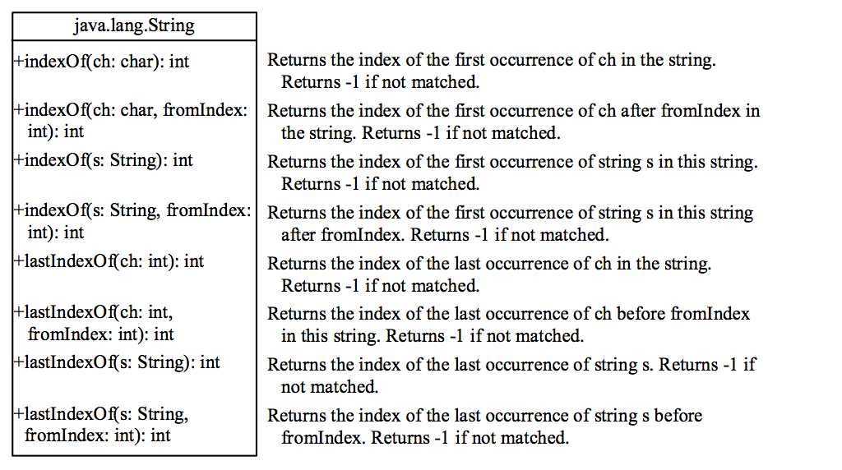
Finding a Character or a Substring in a String

Slide 25
Finding a Character or a Substring in a String
"Welcome to Java".indexOf('W') returns 0.
"Welcome to Java".indexOf('x') returns -1.
"Welcome to Java".indexOf('o', 5) returns 9.
"Welcome to Java".indexOf("come") returns 3.
"Welcome to Java".indexOf("Java", 5) returns 11.
"Welcome to Java".indexOf("java", 5) returns -1.
"Welcome to Java".lastIndexOf('a') returns 14.

Slide 26
Convert Character and Numbers to Strings
The String class provides several static valueOf methods for converting a character, an array of characters, and numeric values to strings. These methods have the same name valueOf with different argument types char, char[], double, long, int, and float. For example, to convert a double value to a string, use String.valueOf(5.44). The return value is string consists of characters ‘5’, ‘.’, ‘4’, and ‘4’.

Slide 27
Problem: Finding Palindromes
Objective: Checking whether a string is a palindrome: a string that reads the same forward and backward.
CheckPalindrome
Run

Slide 28
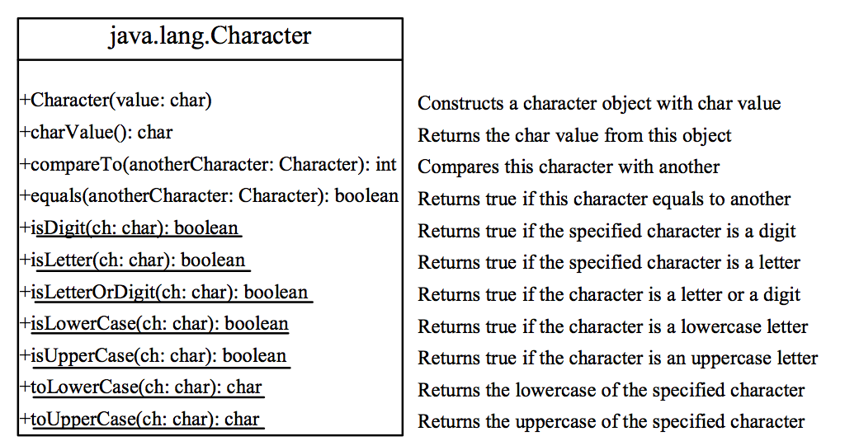
The Character Class

Slide 29
Examples
Character charObject = new Character('b');
charObject.compareTo(new Character('a')) returns 1
charObject.compareTo(new Character('b')) returns 0
charObject.compareTo(new Character('c')) returns -1
charObject.compareTo(new Character('d') returns –2
charObject.equals(new Character('b')) returns true
charObject.equals(new Character('d')) returns false

Slide 30
char type vs Character Class

Slide 31
Special Type: Wrapper Class
What is wrapper class?
Wrapper class in java provides the mechanism to convert primitive into object and object into primitive.
What is ‘autoboxing’ and ‘unboxing’?
The automatic conversion of primitive into object is known and autoboxing and vice-versa unboxing.

Slide 32
Example: Primitive to Wrapper
public class WrapperExample1{
public static void main(String args[]){
//Converting int into Integer
int a=20;
Integer i=Integer.valueOf(a); //converting int into Integer
Integer j=a; //autoboxing, compiler writes Integer.valueOf(a) internally
System.out.println(a+" "+i+" "+j);
}
}
Output:
?

Slide 33
Example: Wrapper to Primitive
public class WrapperExample2{
public static void main(String args[]){
//Converting Integer to int
Integer a=new Integer(3);
int i=a.intValue(); //converting Integer to int
int j=a; //unboxing, compiler writes a.intValue() internally
System.out.println(a+" "+i+" "+j);
}
}
Output:
?

Slide 34
StringBuilder and StringBuffer
The StringBuilder/StringBuffer class is an alternative to the String class. In general, a StringBuilder/StringBuffer can be used wherever a string is used. StringBuilder/StringBuffer is more flexible than String. You can add, insert, or append new contents into a string buffer, whereas the value of a String object is fixed once the string is created.

Slide 35

String vs. StringBuilder
String
String does not allow appending.
Each method you invoke on a String creates a new object and returns it.
This is because String is immutable - it cannot change its internal state.
StringBuilder
On the other hand StringBuilder is mutable.
When you call append(..) it alters the internal char array, rather than creating a new string object.
*StringBuffer is the synchronized version of StringBuilder

Slide 36
String vs StringBuilder
It is more efficient to have:
StringBuilder sb = new StringBuilder();
for (int i = 0; i < 500; i ++) {
sb.append(i);
}
rather than str += i, which would create 500 new string objects.

Slide 37
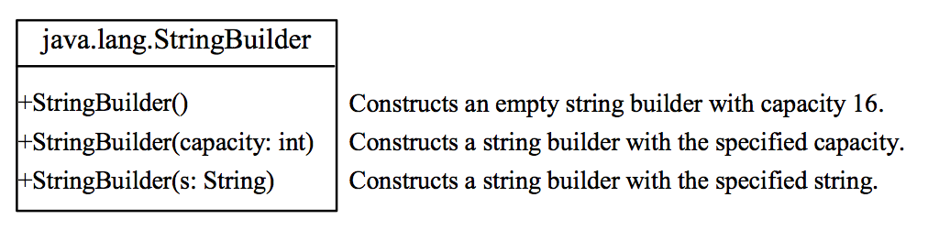
StringBuilder Constructors

Slide 38
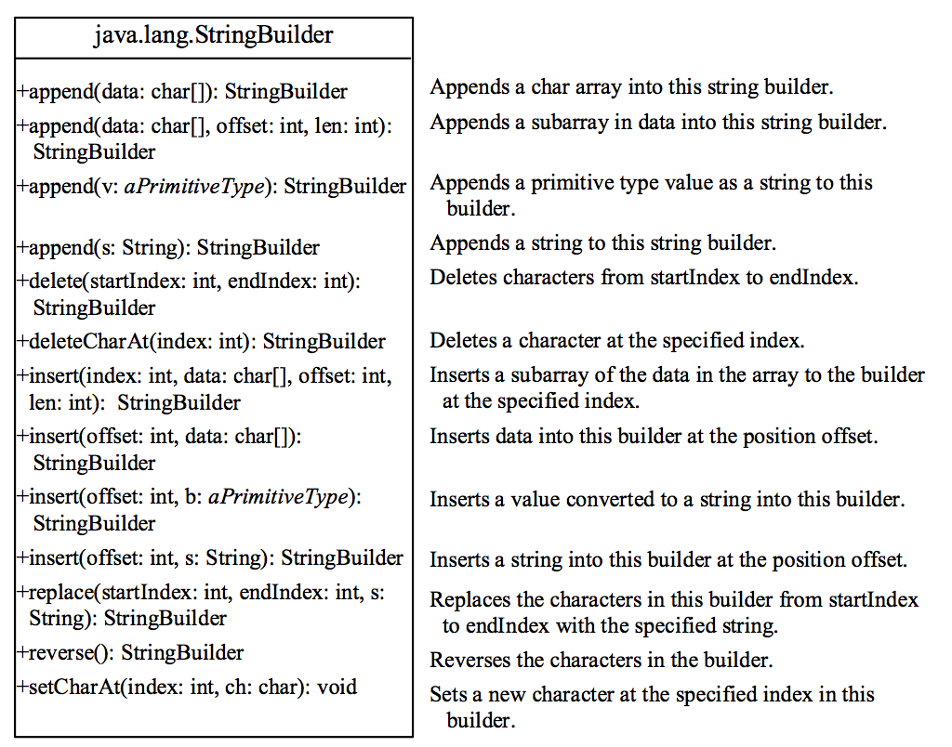
Modifying Strings in the Builder

Slide 39
Examples
stringBuilder.append("Java");
stringBuilder.insert(11, "HTML and ");
stringBuilder.delete(8, 11) changes the builder to Welcome Java.
stringBuilder.deleteCharAt(8) changes the builder to Welcome o Java.
stringBuilder.reverse() changes the builder to avaJ ot emocleW.
stringBuilder.replace(11, 15, "HTML")
changes the builder to Welcome to HTML.
stringBuilder.setCharAt(0, 'w') sets the builder to welcome to Java.

Slide 40
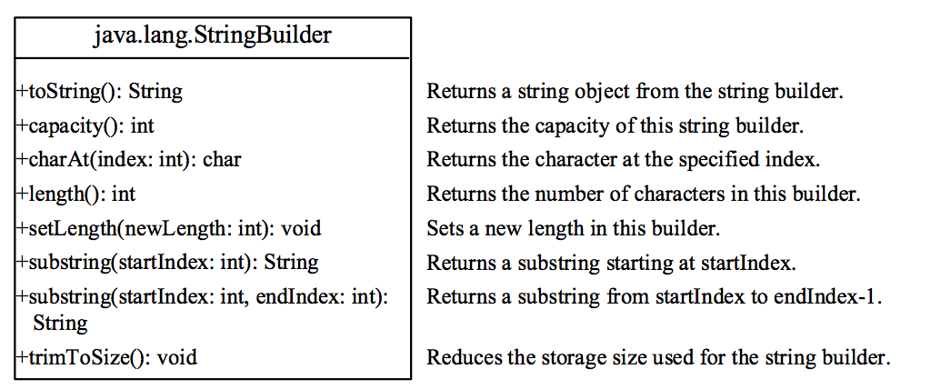
The toString, capacity, length, setLength, and charAt Methods

Slide 41
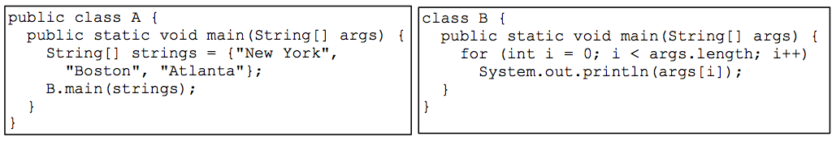
Main Method Is Just a Regular Method
You can call a regular method by passing actual parameters. Can you pass arguments to main? Of course, yes. For example, the main method in class B is invoked by a method in A, as shown below:

